Slide 1
Welcome to IPEIS
Competitive Programming
Club

Slide 2

What is Competitive Programming ?
Competitive programming is solving well-defined
problems by writing computer programs under
specified limits.

Slide 3
Why should we learn
Competitive Programming ?

Slide 4
1-have a lot of fun
2-learn a lot
3-improve your problem solving skills
4-It increases and update your knowledge and will
develop your skills
5-master debugging
6-success in job interviews

Slide 5
How can I learn
Competitive Programming ?

Slide 6
Prerequisites :
1-Self-Motiviation
2-Basics of any programming language : we will use c++.

Slide 7
Getting Started

Slide 8
To practice we will use Online-judges as :
1 - Codeforces.com
2 - SPOJ.com
3 - TopCoder.com
4 - CODECHEF.com
Recommended book : Competitive_Programming3

Slide 9
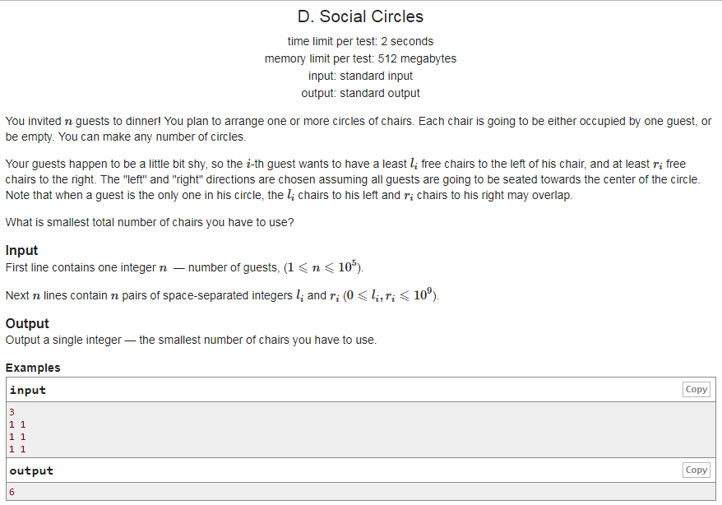
CodeFores.com
Constraints
Problem
statment
input
format
Input example
output
format
output example

Slide 10
What is the role of the IPEIS
Competitive
Programming Club ?

Slide 11
1 - working in group
2 - increase motivation
3 - helping you getting better in programming
4 – solving together between 4-6 problems every week.
5 – boosting your skills and knowledge in programming :
- data structures
- dynamic programming
- bitsmasking
-two pointers
-Graph theory
-number theory
-binary search

Slide 12
What is the Goal of the IPEIS
Competitive
Programming Club ?

Slide 13
The goal of the club is to prepare you to compete in
competitive programming contests at the end of the year :
-SCPC ( Sfax Collegiate Programming Contest )
-TCPC ( Tunisian Collegiate Programming Contest ).
And other contests ..

Slide 14
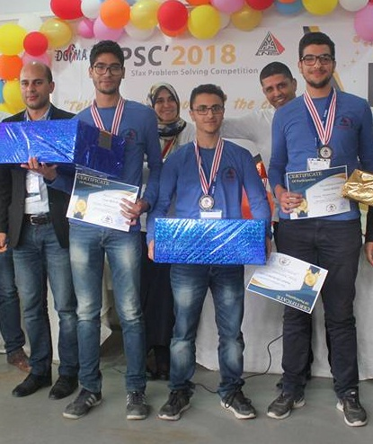
SPSC 2018 (Bronze Medal)

Slide 15
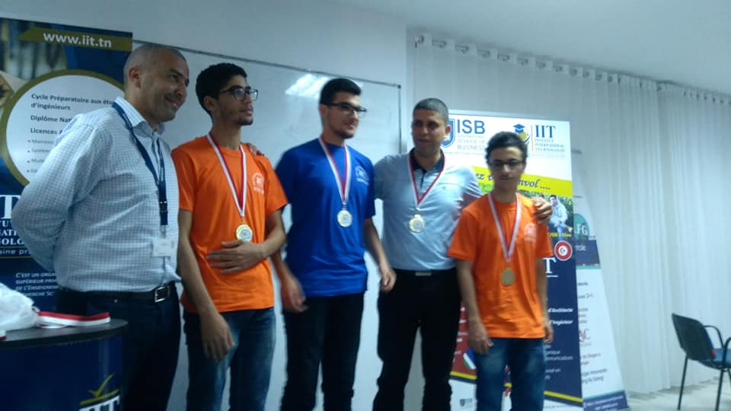
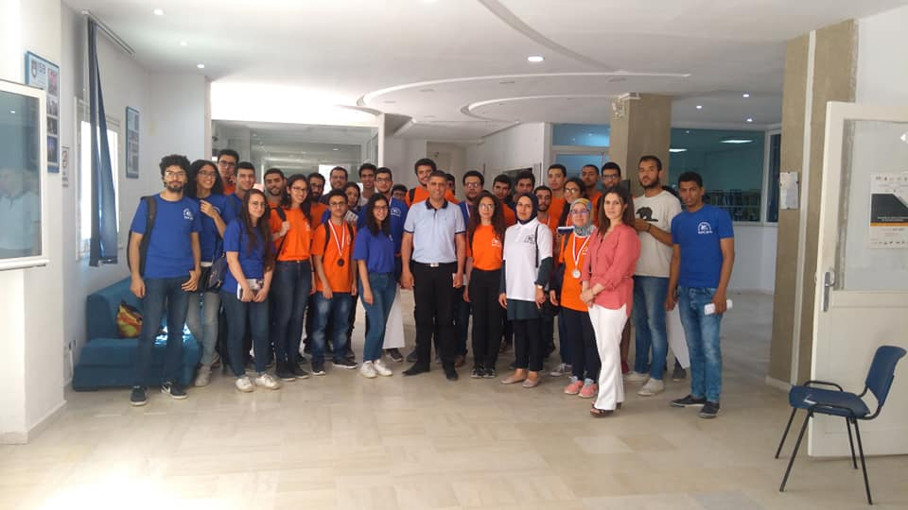
SCPC 2018 (Gold Medal)

Slide 16
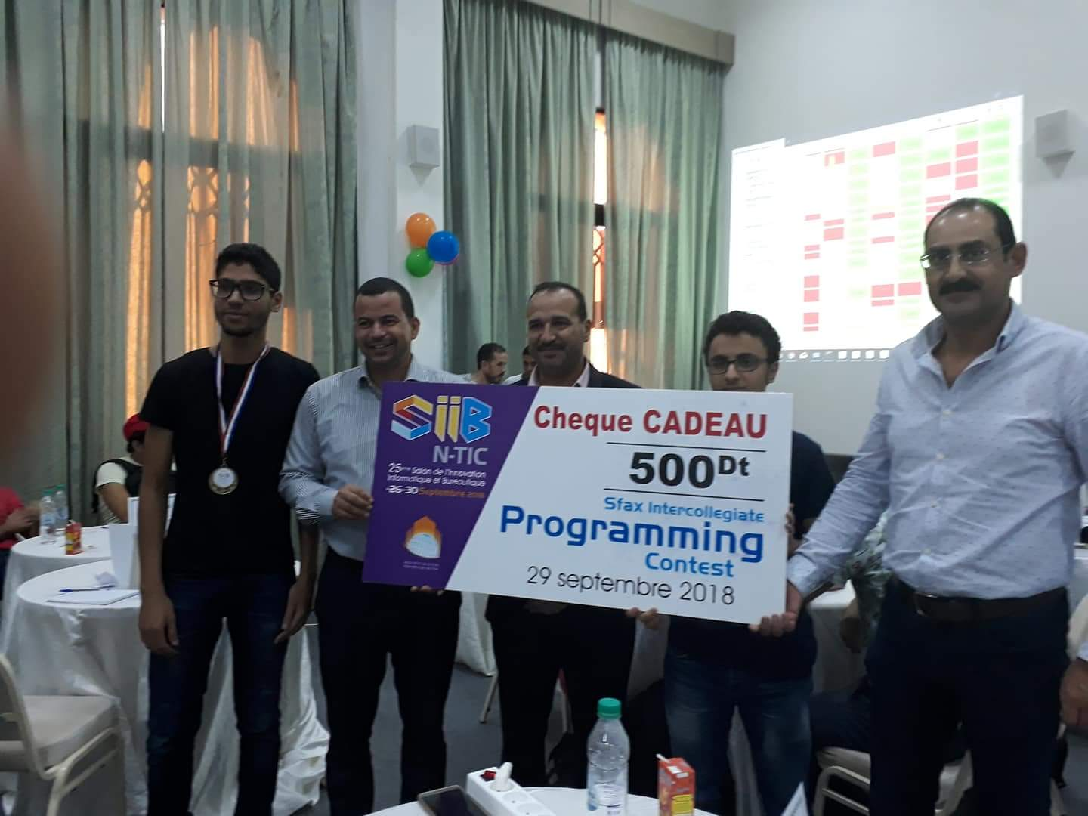
SIPC 2018 (Bronze Meda)

Slide 17
Thanks for listening ,
Let’s start coding

